Slide 1
Redux
By Prateek Magarde
https://egghead.io/courses/getting-started-with-redux

Slide 2
Redux – Introduction
Redux is a predictable container for Javascript apps
It was inspired by facebook flux
It can be used by React or any other library

Slide 3
Redux – Principles
Single source of truth which is state
State is read-only
Changes are made by Pure functions by triggering an action

Slide 4
Redux – Single Source of Truth
The application state is stored in a single location
Do not scatter the state over lts of components

Slide 5
Redux – state is read-only
The state objects are never changed directly by the application
Every state change is the result of an action being dispatched to the store
This action describes the intended state changes

Slide 6
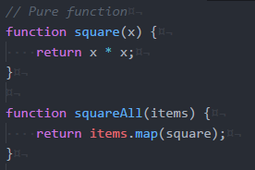
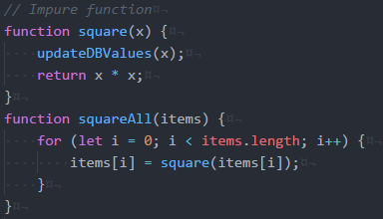
Redux – Pure functions
The return values of pure function is depends on its args Hgence, if you call
the pure function with the same set of args, you will always get the same values
They do not have any side effects like network, database calls
They do not modify the args passed to the pure function

